Slide 1
Python week 4
Canberra Chinese School Sem3

Slide 2


Continuing Turtle (as promised)
Last time…

Slide 3
Continuing Turtle (as promised)
Last time…
Today we are doing something similar

Slide 4

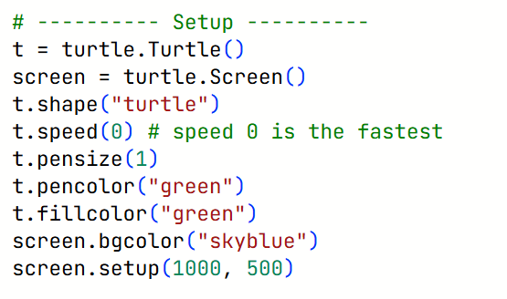
Turtle revision
Setup

Slide 5
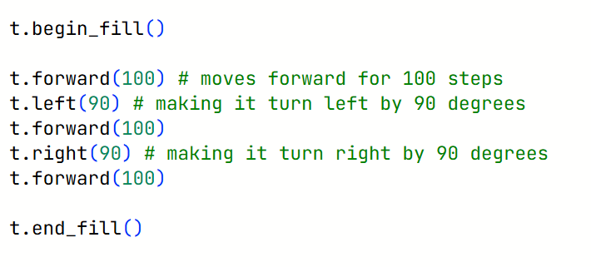
Turtle revision
Basic functions review

Slide 6
Turtle
Let’s draw a picture of a beautiful garden.
Now, before we start, we need to have a plan…

Slide 7
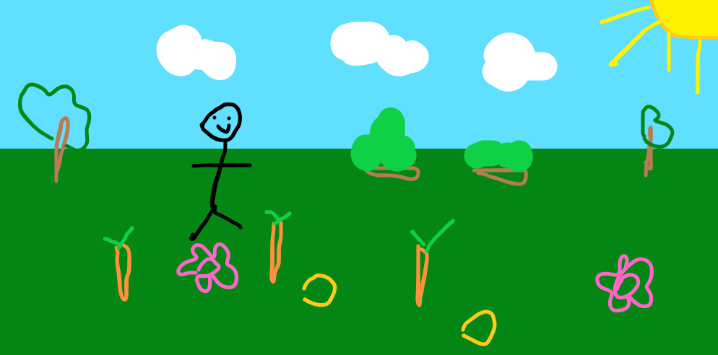
Turtle
Quick sketch of what our garden is going to look like

Slide 8
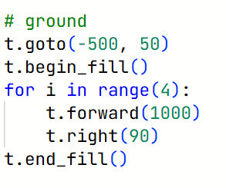
Turtle
Let’s get started with the ground

Slide 9
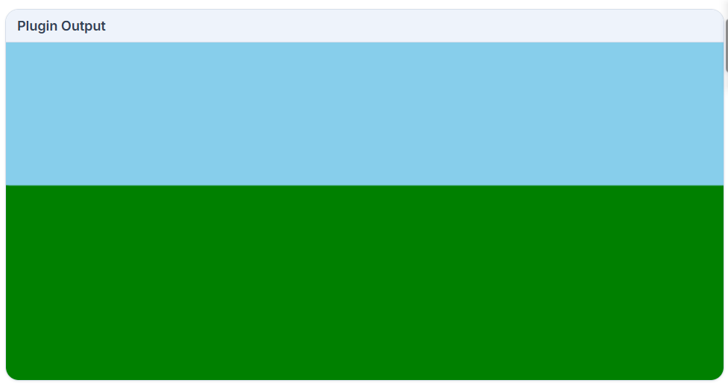
Turtle
Let’s get started with the ground

Slide 10
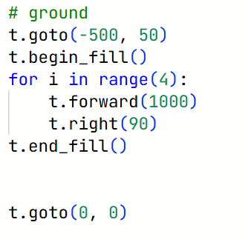
Turtle
Remember to reposition the turtle to the center

Slide 11
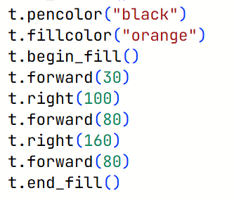
Turtle
Let’s draw a carrot

Slide 12
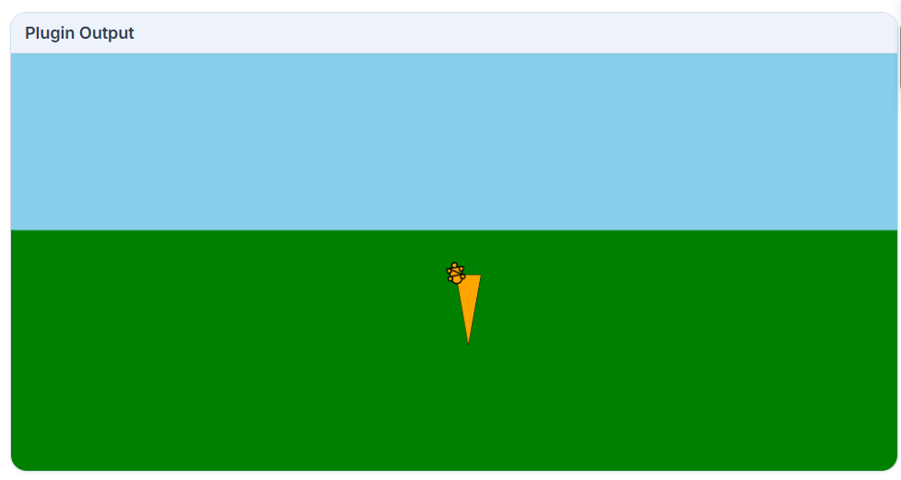
Turtle
And let’s add the stems/leaves

Slide 13
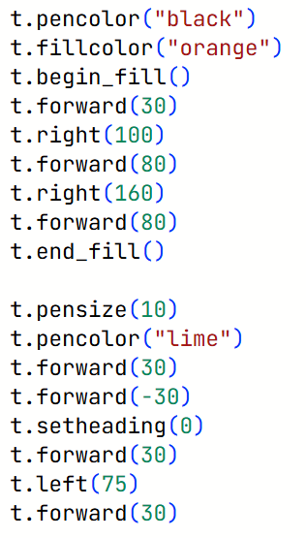
Turtle
And let’s add the stems/leaves

Slide 14
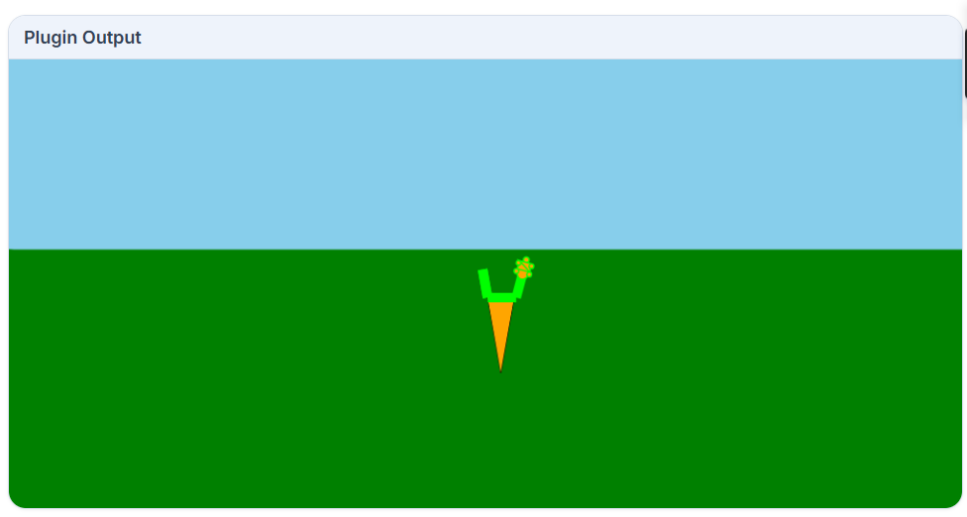
Turtle
There we go. We have a carrot now.

Slide 15
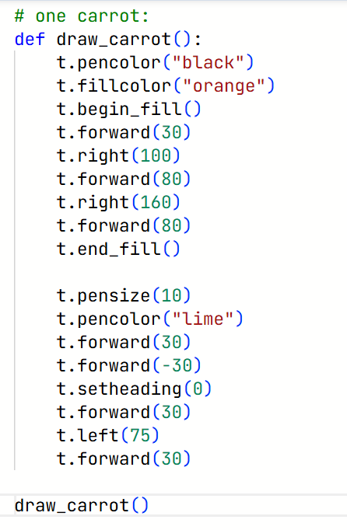
Turtle
Let’s make it a function so that
we can just call the function if
we want more carrots.

